Slide 1
Total Prison Population from 2008-2022
Maia Vachon

Slide 2



Data Sources
Bureau of Justice Statistics: data from 1979 to 2022, arrest data by state
FBI: data from 1995 to 2022, Uniform Crime Reporting Program (UCR), prison population data by state
Bureau of Economic Analysis: data from 1997 to 2022, real GDP data by state

Slide 3
Data Cleaning
Too many ideas!
Wanted data from 2008-2022, but couldn’t find a good compiled dataset – had to download a lot of separate csv files, especially for prison populations and crime data
Matching index for GDP and Prison Population datasets
SIDENOTE: how Covid has affected total prison populations
In most states, arrest data severely dropped during Covid (as expected) but in 2022, it skyrocketed in most states – something to study later!

Slide 4
Linear Regression with Lag(s)
Training and testing sets, seeing if GDP of a certain year had an affect on total prison populations
1. simple linear regression
2. linear regression with one lag – GDP from the previous year matched with total prison population of the year in question
3. linear regression with multiple lags

Slide 5
Results
1. r-squared: 0.4622
2. r-squared: 0.4586
3. r-squared: 0.396
Lagging didn’t do much and overall, the model may not be the best to understand total prison populations

Slide 6
Forecasting
We never dealt with multivariate forecasting in DATA 300.
But predicting total prison populations based on factors such as GDP, different types of crime, % of arrests, etc. could be interesting!
ARIMA: designed for time series predictions of future values based on historical patterns
ADF test, KPSS test – tests for stationary data
Results: strong evidence against the null hypothesis – the data is stationary
PACF and ACF plots to determine AR and MA orders – (1,0,0)

Slide 7
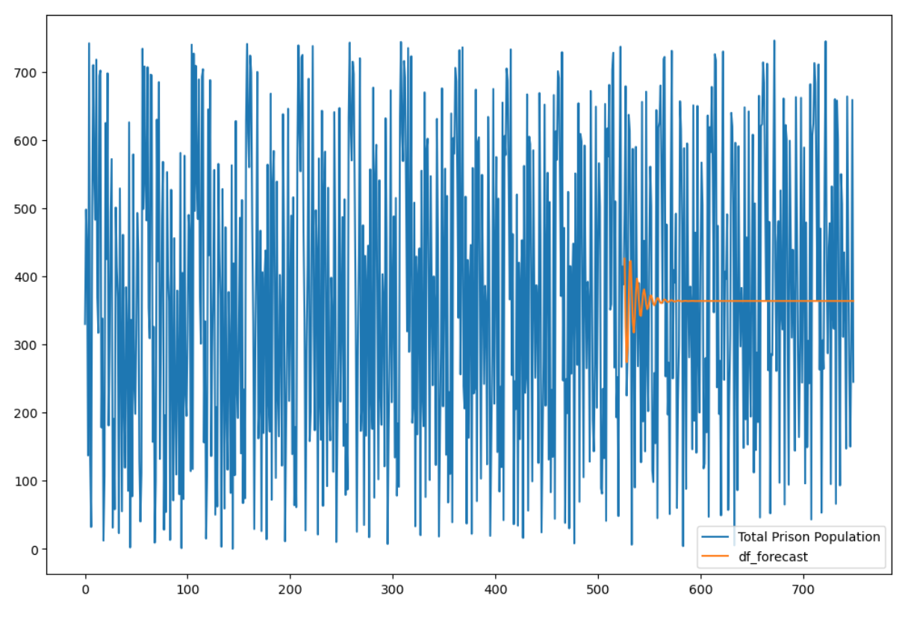
Not good…

Slide 8
Problems
ARIMA assumes linear data – may need to preprocess the data more before throwing it in
Differencing??? – there’s likely something wrong with my ADF and/or KPSS test code since both of them said the data was stationary
Multivariate forecasting is complicated!

Slide 9
Future Possibilities
Crime data – property, violent, rape, drug abuse, arson, robbery, disorderly conduct, murder and manslaughter
Other variables that might contribute to total prison populations in each state
Larger time-period and/or monthly data
Regional data rather than state data – look into regional policing policies
Demographic data – race, gender, socioeconomic status, etc.
How has Covid affected total prison populations and how do we expect it to keep changing??

